Slide 1
QWIRE: A Core Language for Quantum Circuits
Ashlesha Atrey

Slide 2
Why is circuit model so successful?
Low level of abstraction
Qubits are unintuitive from a classical perspective
Not much progress in conditionals and recursions
Notes:
Still researchers write complex algorithms in state of art quantum circuit language like quipper
So programmers not sure if their approach will work

Slide 3
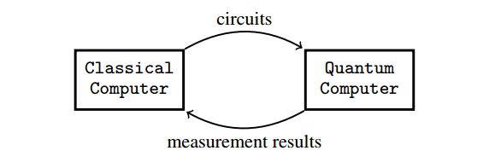
QRAM model
Embedded language like Quipper,
LIQUi|>, Q language, Quanum IO
Monad
Notes:
Doesnt specify the degree to which the separation is intended

Slide 4
QRAM Model : QWIRE
QWIRE design:
Separation of classical computation in host language from quantum computation in the circuit language
Syntactically separates quantum data inside circuits from classical data, and treats these two syntactic fragments as distinct languages.
We need correctness, as they already are expensive and error prone
Notes:
Proving embedded language produces well formed circuits is hard, it means reasoning about the entirety of host language

Slide 5
Type safety languages
Ensure Well formed circuit dont get stuck
Semantics for programs in terms of quantum mechanics
Selinger’s QPL language (Selinger 2004)
quantum lambda calculus (Selinger and Valiron 2009)
QML (Altenkirch and Grattage 2005),
ProtoQuipper (Ross 2015).
However, these are toy languages, not designed for implementation in a conventional programming environment

Slide 6
QWIRE: Type safety
Keeping circuit language minimal and pushing the remaining infrastructure to host language
Quipper and LIQUi|i do not cleanly separate embedded circuits from the host language
Run time error can only occur in host language in QWIRE

Slide 7
Qwire
A core language for quantum circuits
Safe:
Linear types for wires
Type safety & strong normalization
Denotational semantics
Expressive:
Structured based on QRAM model
Embedded in our favourite classical host language

Slide 8
Circuit Language
Wire types:
unit (has no data), a bit or qubit, or a tuple of wire types
W ::= 1 | bit | qubit | W1 ⊗ W2
Type judgment:
Γ ; Ω ⊢ C : W
C is a circuit
Ω = w1 : W1, . . . , wn : Wn is a context of input wire names with their wire types
Γ = x1 :A1, . . . , xn : An is a context of host language variables with their host language types
W is the output type of the circuit.

Slide 10
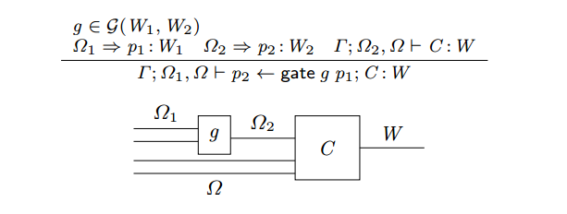
Examples: Gate
A gate can be applied to a pattern of wires when permitted by
the signature of the gate.
The output of that gate is then decomposed by another pattern.
The wires exiting the gate can then be used in the remainder of the circuit.
Gate Model: G(W1, W2)
for the set of gates with input W1 and output W2.

Slide 11
Examples: Compose
We compose circuits by connecting the output of one circuit to
the input wires of another. This operation differs from sequential
composition in that the second circuit may have additional inputs.

Slide 12
Host Language: HOST
The classical computer communicates with the quantum computer by sending it instructions—that is, circuits in QWIRE.
For each wire type there is a corresponding classical type—for example, a host-level boolean might correspond to the qubit and bit wire types, and tensor wire types correspond to pairs.

Slide 13
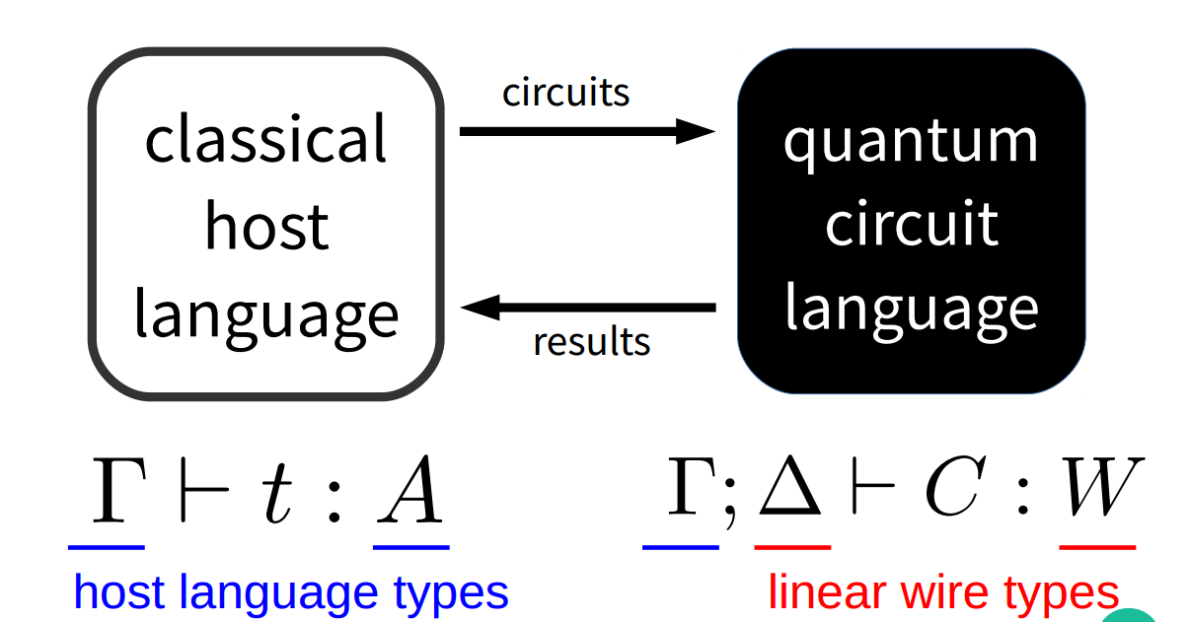
Types of Hosts
Types of Hosts:
A ::= · · · | Unit | Bool |
A × A | Circ(W1, W2)

Slide 14
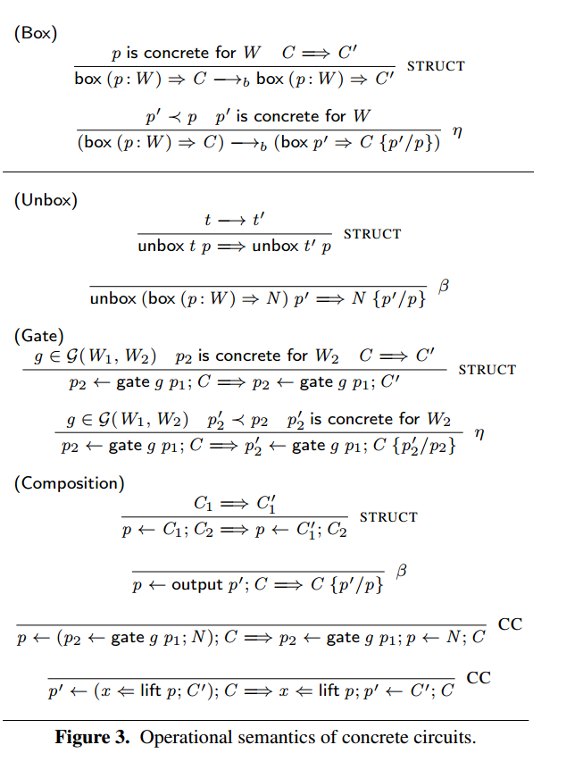
Typing rules for QWIRE
OUTPUT
GATE
COMPOSE
LIFT
UNBOX
BOX

Slide 15
Boxes
The type Circ(W1, W2) is a wrapper around
QWIRE circuits of the form Γ ; Ω ⊢ C : W2, where the wires in
Ω come from a pattern destructing the input type W1.

Slide 16
Communication: Dynamic and static lifting
Quantum computer communicating with classical computer
Γ ; · ⊢ C :bit
Γ ⊢ run C :Bool
Wire Types to classical types:
|bit| = Bool
|qubit| = Bool
|1| = Unit
|W1 ⊗ W2| = |W1| × |W2|

Slide 17
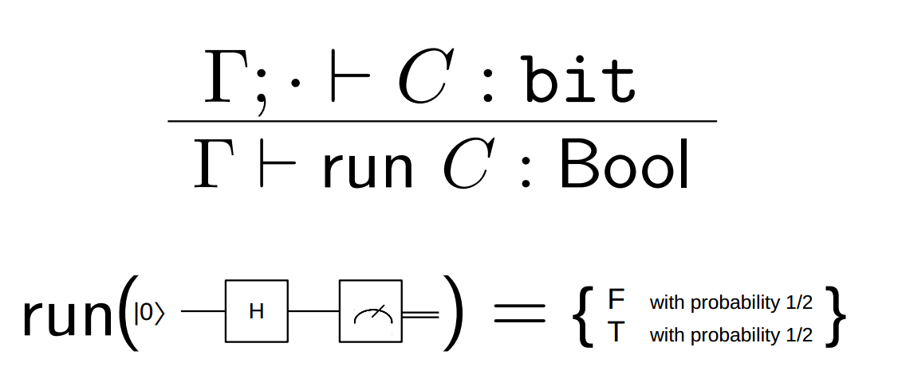
Running circuit: static lifting
Notes:
Run is a static lifting operator, meaning that there is no residual
state left on the quantum computer after run C has completed.

Slide 18
Dynamic Lifting: communicate with classical
x ⇐ lift p; C
to mean that the wires in p are measured, lifted to the classical computer as
the host variable x, and used to compute the circuit C
Notes:
Dynamic lifting is expensive because while the classical computer is computing the rest of the circuit, the existing state on the quantum computer must continuously undergo error correction to prevent degradation

Slide 19
Circuit Normalization
Circuits in QWIRE represent instructions to be executed on a quantum computer: either apply a particular gate, or request a dynamic lifting operation.
Eliminate unboxing and composition
Two rules:
Operate only on bit and qubit - concrete circuit
Consists only of gate applications, outputs, and dynamic lifting operations - Normal circuit

Slide 20
Advantages of QWIRE:
Interface to circuit is minimal
Host language is extensible, since changes to host language dont induce changes to the circuit language
Relationship between circuit language and host language can be easily axiomatized
Every circuit can be promoted to the host language via a box operator, and then unboxed to be reused inside of other circuits.

Slide 21
In paper
Operational semantics of circuit
Proof of type safety
Progress and preservation threomes
Proof of strong normalization
Denotational semantics: proof of soundness
Dependently typed circuits

Slide 22
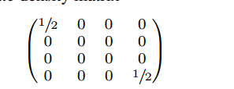
Denotational Semantic
Quantum system describe as density matrix
W1 to W2 interpreted as a superoperator mapping density matrices corresponding to W1 to density matrices corresponding to W
Measure

Slide 23
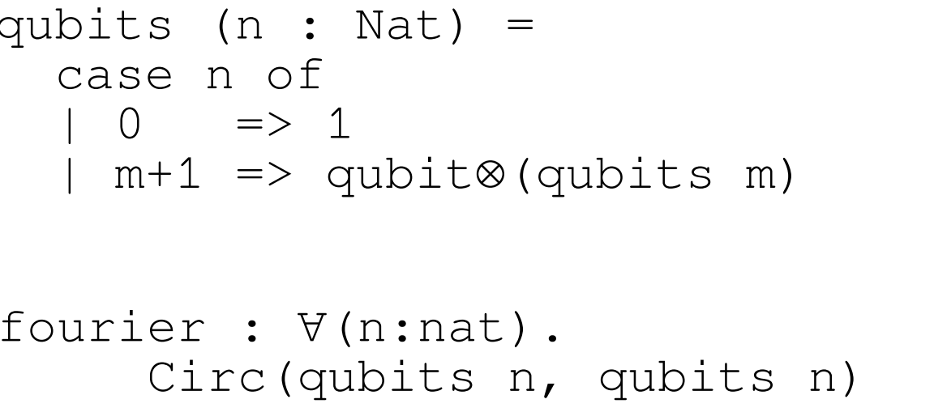
Dependent Types
Circuit with n inputs and n outputs
Types can depend on terms, but only terms of classical (non-linear) type

Slide 24
Summary
Minimal and highly modular core language
5 commands with two eliminated using Normalization
Not attached to any specific core language
Uses linear types to enforce no-cloning
Safe, small circuit level language

Slide 25
Discussion
Parametric Operators on Circuits
Automatic generation of Quantum Oracles
Scalability
Quantum Data Types

Slide 26
THANK YOU!
Questions?

Slide 27
References
QWIRE: a core language for quantum circuits.
Jennifer Paykin, Robert Rand, Steve Zdancewic. POPL'17.

