Slide 1
Implementing a Distance-based Classifier with a Quantum Interference Circuit
Maria Sculd, Mark Fingerhuth and Francesco Petruccione
University of KwaZulu-Natal, University of Maastricht and National Institute of Theoretical Physics, KwaZulu-Natal
Slides by: Varun Garg

Slide 2
Contents
Motivation
The Math Involved
The Interference Circuit
Example
Experimental Results
Discussion

Slide 3
Motivation
Current quantum ML algorithms require non-trivial circuits
Quantum ML algorithms require amplitude amplification
SVMs in quantum require quantum matrix inversion or density matrix exponentiation
Current ML algorithms based off classical algorithms
Build ML algorithm with Quantum in mind

Slide 4
The Math Involved
Use a supervised learning approach
Dataset with labels present
Labels are binary
Classification of unknown points made on distance from points in dataset

Slide 5
The Dataset
D = {(x¹, y¹), (x², y²), … (x^{M}, y^{M})}
x^{m} ∊ R^{N}
y^{m} ∊ {-1,1}
x~ is the unlabeled input

Slide 6
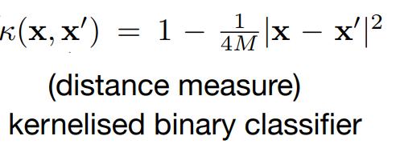
Classifier Equation
Distance from all points calculated
y^{m} is the label for m^{th} data point
Notes:
Simple classifier equation
Epanechnikov

Slide 7
State Preparation
Need to create quantum equivalent of classifier
Generate state with dataset points and labels
Add input point and calculate probabilities for the labels

Slide 8
Transforming to Quantum Space
Now, apply the H gate to the ancilla bit and conditional measure when ancilla bit |0>
The H gate will give us the equation of the required form
Notes:
Creating the state, M number of points in set, C is normalization constant, Psi x is the n qubit system denoting a point.

Slide 9
We need the probability for ancilla bit value 0

Slide 10
For the class qubit y^{m} =0, the probability is
If vectors are normalized, then

Slide 11
Quantum - Classical
Label decided on probability of qubit being 1 or 0
Label is -1 if summation < 0 or 1 if summation > 1

Slide 12
The Interference Circuit

Slide 13
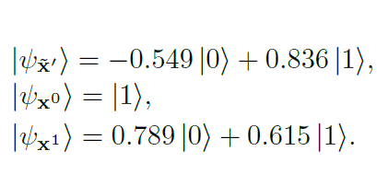
Example
X0 and x1 are labeled points as 1 and -1 with 2 features
X’ is the input unlabeled point
X’ has label -1

Slide 14
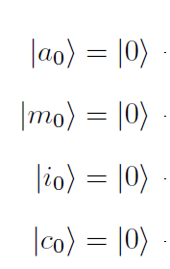
Circuit
Ancilla
Index
Data
Class (Final result)

Slide 15
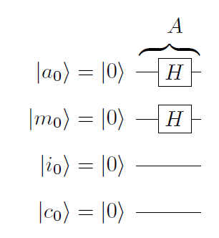
Circuit
Ancilla and Index put into uniform superposition

Slide 16
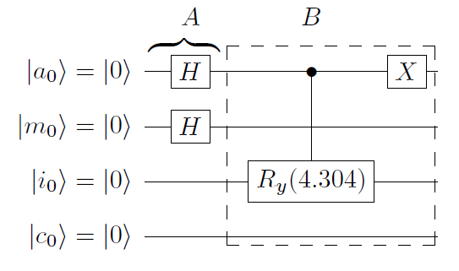
Circuit
The unlabeled x is entangled with the ancilla bit

Slide 17
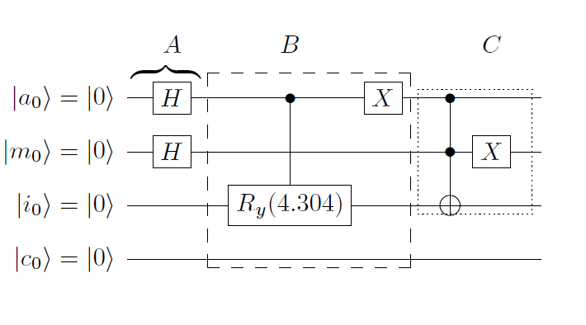
Circuit
x0 is entangled with the ancilla and index qubits

Slide 18
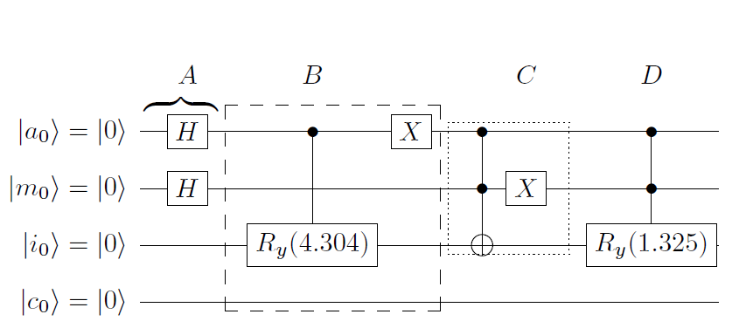
Circuit
x1 is entangled with the ancilla and index qubits

Slide 19
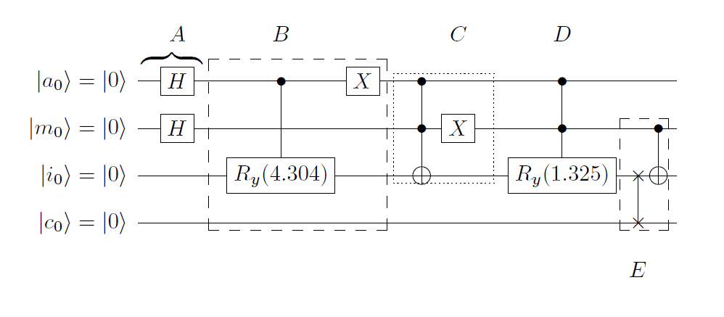
Circuit
Swap input and class bits and CNOT class if index is excited

Slide 20
Circuit
Measure class qubit if ancilla is 0
Notes:
https://algassert.com/quirk#circuit={%22cols%22:[[%22H%22,%22H%22],[%22%E2%80%A6%22,%22%E2%80%A6%22,%22%E2%80%A6%22,%22%E2%80%A6%22],[%22%E2%80%A2%22,1,%22~h119%22],[%22X%22],[%22%E2%80%A6%22,%22%E2%80%A6%22,%22%E2%80%A6%22,%22%E2%80%A6%22],[%22%E2%80%A2%22,%22%E2%80%A2%22,%22X%22],[1,%22X%22],[%22%E2%80%A6%22,%22%E2%80%A6%22,%22%E2%80%A6%22,%22%E2%80%A6%22],[%22%E2%80%A2%22,%22%E2%80%A2%22,%22~m6vn%22],[%22%E2%80%A6%22,%22%E2%80%A6%22,%22%E2%80%A6%22,%22%E2%80%A6%22],[1,%22%E2%80%A2%22,1,%22X%22],[%22H%22],[%22|0%E2%9F%A9%E2%9F%A80|%22]],%22gates%22:[{%22id%22:%22~h119%22,%22name%22:%22Ry(4.304)%22,%22matrix%22:%22{{-0.5468693,-0.837218},{0.837218,-0.5468693}}%22},{%22id%22:%22~m6vn%22,%22name%22:%22Ry(1.325)%22,%22matrix%22:%22{{0.788494,-0.6150424},{0.6150424,0.788494}}%22}]}

Slide 21
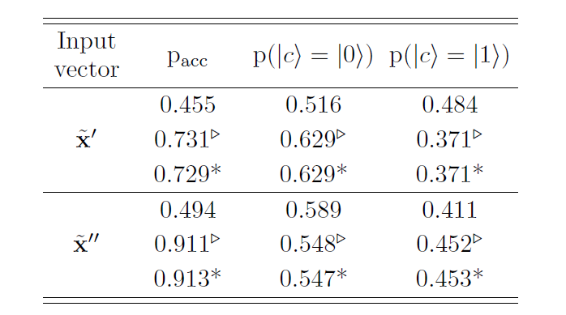
Experimental Results
Triangles are simulated on IBM QX
Asterisks are theoretical predictions
https://goo.gl/kY26xz

Slide 22
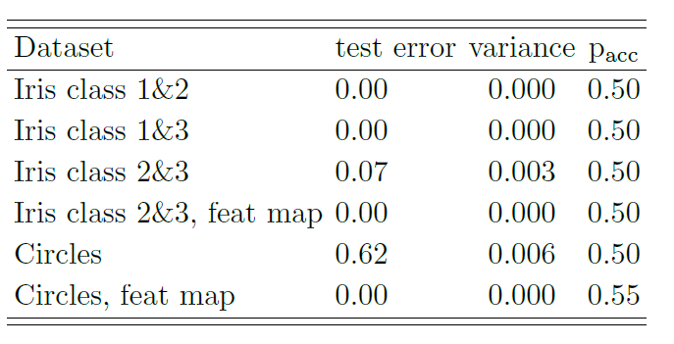
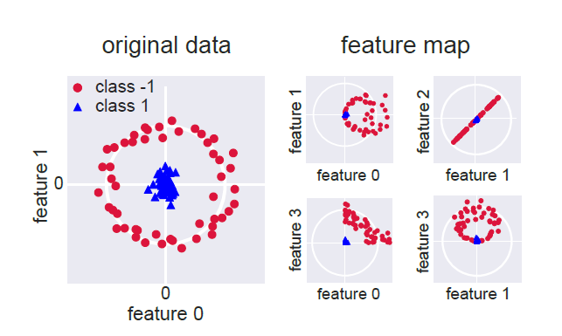
More results
Map data to new space if cannot be divided linearly

Slide 23
Open Problems
Implementing various different kernels for the circuits (different distance functions) – increase in flexibility
Solve the decoherence issues

Slide 24
Thank You

Slide 25

$|\left.D\right\rangle = \frac{1}{\sqrt{2MC}} \sum_{m=1}^{M}{|\left.m\right\rangle \left(|\left.0\right\rangle \right.}$ $\left|\left.Ψx^{\sim }\right\rangle +\left|\left.1\right\rangle \right|\left.Ψx^{m}\right\rangle \right) \left.{|y}^{m}\right\rangle$

