Slide 1
Magic-State Functional Units: Mapping and Scheduling Multi-Level Distillation Circuits for Fault-Tolerant Quantum Architectures
Yongshan Ding, Adam Holmes, Ali Javadi-Abhari, Diana Franklin, Margret Martonosi, and Frederic Chong
Presented By: Malcolm Regan

Slide 2
Magic State Functional Units...
In this paper:
- Heuristics for optimization of computationally expensive fault-tolerance circuitry (specifically, “magic state factories”) are identified
- Methods to enforce these heuristics are described and analyzed
- Based on the strengths and weaknesses of these methods, an optimization scheme is proposed and tested

Slide 3
Background: Magic States
Surface codes only provide fault tolerant implementation of Clifford gates:
[ ]
[ ]
[ ]
1 1
1 -1
1 0
0 i
I 0
0 σ^{x}
H = 2^{-½}
K =
CNOT =
For full quantum computation a phase gate must be included in the instruction set
[ ]
1 0
0 e^{iθ}
Where θ is not a multiple of π
R(θ) =

Slide 4
Background: Magic States
Fault-tolerant implementation of R(θ) can be achieved through the use of high-fidelity ancilla bits in the state
[ ]
1 0
0 e^{iθ}
R(θ) =
| A > = 2^{-½} ( | 0 > + e^{iθ}| 1 > )
These are called magic states
This paper focuses on the magic states for the T gate where
θ = π/4

Slide 5
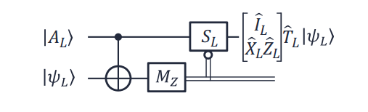
Background: Magic States
The T-gate operation can be fault tolerantly performed on an arbitrary state
| ψ > = a | 0 > + b | 1 >
through interaction with a magic T-state, Clifford operations and measurements

Slide 6
Background: Magic States
M_{Z} will have an eigenvalue of either +1 or -1
If M_{Z} yields an eigenvalue of +1, the circuit will yield T | ψ >
If M_{Z} yields an eigenvalue of -1, the circuit will yield T† | ψ >. If magic state resources are available, a rotation XZS acheives the state T | ψ >.

Slide 7
Background: Magic State Distillation
Initial, dirty T-states can be created in the surface code.
These dirty T-states can be distilled to high-fidelity magic states through iterative use of the T circuit below and many stabilizer measurements

Slide 8
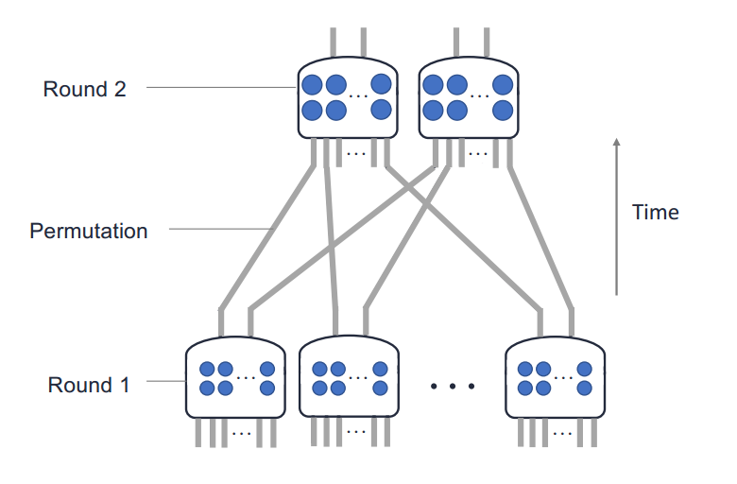
Background: Bravyi-Haah Distillation
Bravyi-Haah is a popular low-overhead protocol for distillation of magic states
Uses syndrome measurement to verify quality of input states and discards the bad, suppressing error at output
Input error rate = ε
Output error rate = (1+3k)ε²
So, ε < 1/(1+3k)
Output: k refined states
Input: 3k + 8 unrefined states
k + 5 ancillary qubits
k addl. qubits for output

Slide 9
Background: Block Code Distillation
This paper considers the optimization of a distillation circuit made of Bravyi-Haah modules in successive rounds.
Distillation circuits in this leveled structure are called block codes.

Slide 10
Background: Block Code Distillation
Errors in outputs of a given Bravyi-Haah module may be correlated
To prevent propagation of these errors, all outputs of a module must each be input into different modules in the next round.

Slide 11
Motivation
T-gates make up a large part of most useful quantum circuits
Each T-gate needs substantial magic resources to be implemented fault-tolerantly
Proposed fault tolerant architectures dedicate large areas to the production of magic states, “magic state factories”
This paper is motivated by the need to minimize the latency and area of this expensive circuitry

Slide 12
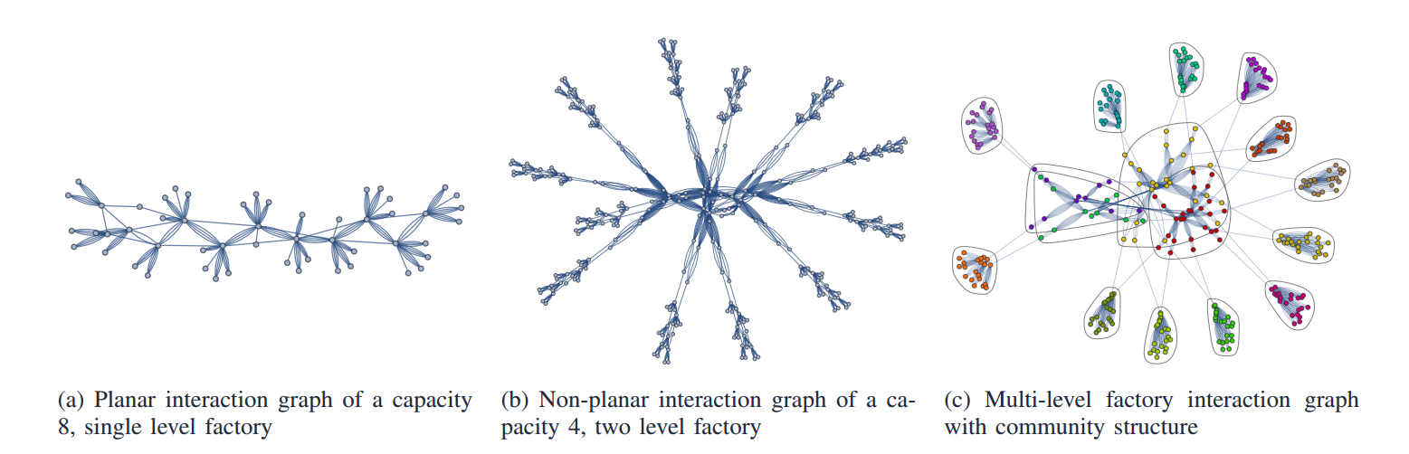
Circuit Interaction Graph
Mapping optimizations in this paper use a program interaction graph to represent the distillation circuit
Vertices represent logical qubits
Edges represent 2-qubit gates (CNOTs)

Slide 13
Circuit Interaction Graph
One of the main optimization goals is to obtain a graph with minimal edge crossings
Edge crossings correspond to braid conflicts when the graph is mapped to the physical 2D surface code mesh
When 2 braids cross, they can not both be active at once, resulting in extra computation cycles

Slide 14
Circuit Interaction Graph
Single-level factory:
Planar graph – can be mapped nearly optimally
Multi-level factory:
Made of planar single-level graphs
but the required inter-round permutations break the planarity of the overall graph

Slide 15
Circuit Interaction Graph
These circuit interaction graphs can be defined once the particular schedule of gate operations is established

Slide 16
Gate Scheduling Considerations
Schedule of quantum program defines the sequence of gate operations – which qubits interact and when.
Authors explored previously studied quantum scheduling techniques and found them ineffective in improving case of the Bravyi-Haah block code circuit.
As such, no specific optimizations were made to the schedule. However, modifications to the scheule which resulted in a more favorable interaction graph were explored.

Slide 17
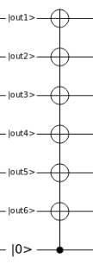
Scheduling: Barrier Insertion
The authors found that inserting a barrier (multi-target CNOT) into the schedule could be used to make clean divisions in the graph between rounds of the block code.
This exposes the planar subgraphs of the single-level factories that were lost due to the permutations between rounds.
Planar graphs are more straight forward to map optimally

Slide 18
Scheduling: Qubit Reuse
Ancilla qubits used for measurement in Bravyi-Haah modules can be reinitialized in between levels of the block code and reused in later levels.
Qubit reuse saves circuit area at the expense of latency
Not allowing qubit reuse saves computational cycles at the expense of circuit area
The authors explore this tradeoff in their analysis

Slide 19
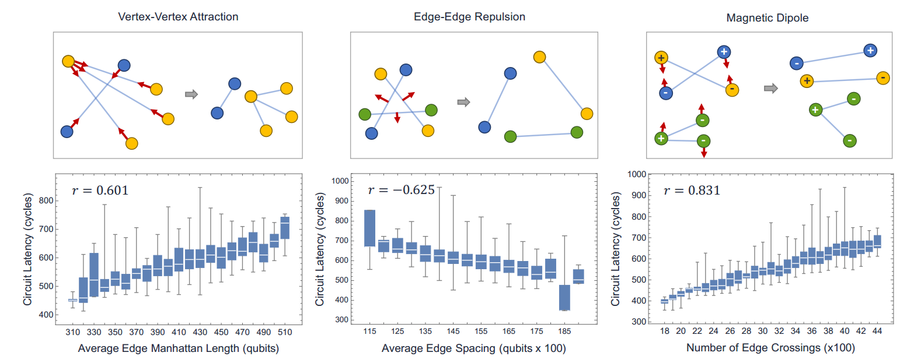
Qubit Mapping Considerations
Metrics of quantum circuits and interaction graphs mesh show high correlation with circuit latency
Intuitively these metrics can be understood to be correlated with the number of braid conflicts in a circuit.

Slide 20
Qubit Mapping Considerations
Based on this, an interaction graph with
- Shorter edges
- Edges with large spacing between them
- Minimal edge crossings
should result in a faster circuit

Slide 21
Mapping: Simulated Annealing
- Heuristics are encoded as forces acting on vertices and edges of the graph
- Allowing the forces to equilibrate results in a more optimal graph configuration

Slide 22
Mapping: Simulated Annealing
- Once a local minima is reached, a community detection algorithm groups together heavily interacting vertices
- Members of a given community are pulled toward eachother and different communities are pushed away
- This frees the graph from the local minima and the annealing- community detection cycle is repeated

Slide 23
Mapping: Graph Partitioning
Simulated annealing was compared with a graph partitioning technique:
1) Heavy edges are identified
2) Random heavy edges are selected and collapsed into a vertex comprised of its two original vertices

Slide 24
Mapping: Graph Partitioning
3) This is repeated until no more edges can be collapsed into two vertices
4) The resulting coarse graph is partitioned with a minimum cut
5) The graph is expanded to the original graph and the process is repeated

Slide 25
Mapping: Graph Partitioning
Each partition of the graph is mapped to a partition physical qubit grid
This groups highly interacting qubits and isolates these groups, potentially avoiding braid conflicts

Slide 26
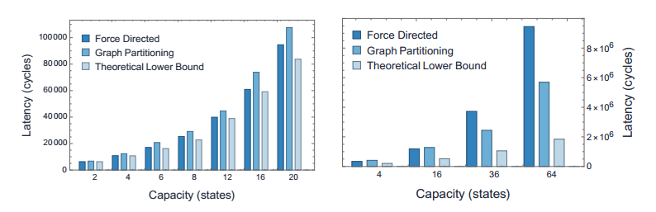
Annealing vs. Partitioning
Single-level factory
Two-level factory
Theoretical lower bound is critical path not including stalls from braid conflicts

Slide 27
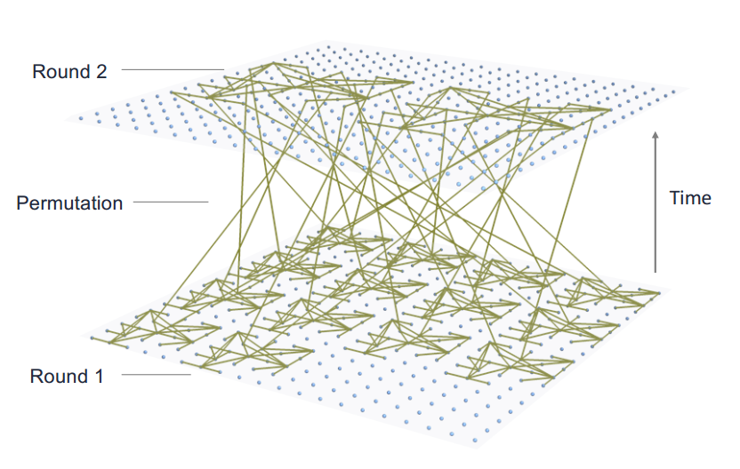
Hierarchical Stitching Method
Based on the scheduling and mapping techniques discussed earlier an optimization procedure that leverages of strengths of each is developed

Slide 28
Hierarchical Stitching Method
The Hierarchical Stitching Method has two phases
1) Intra-round optimization
2) Inter-round optimization

Slide 29
Hierarchical Stitching Method
Intra-round optimization:
- Barriers between rounds allow each round to be isolated and optimized individually
- Individual modules optimized with partitioning method separately as modules of a given round do not interact

Slide 30
Hierarchical Stitching Method
Inter-round optimization:
- Intermediate destinations between each output and input state are added
- They are moved into an optimal position using force directed annealing
- This allows the permutation routes to bend and avoid braid conflict

Slide 31
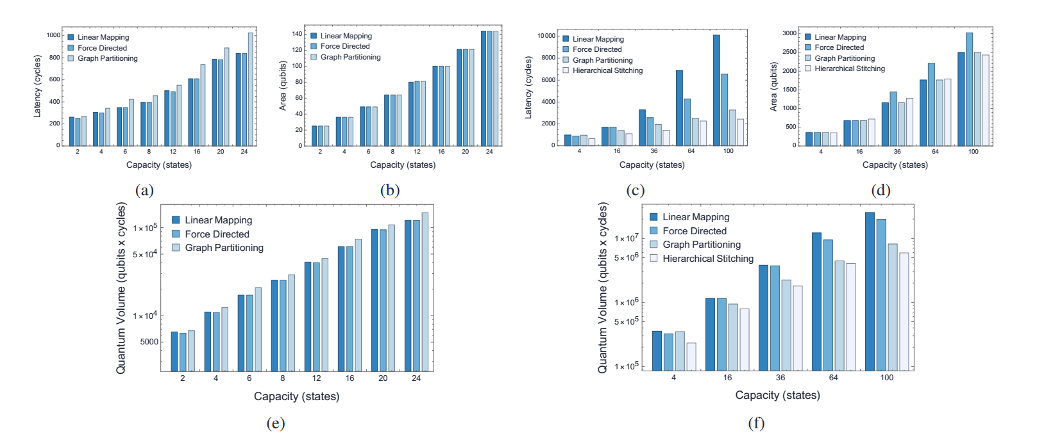
Results: Single-Level
- Force directed annealing method slightly beats out the hand-optimized baseline circuit (Linear Mapping)
- This is due to the strong correlation between the metrics which force-directed annealing optimizes and the latency of the circuit

Slide 32
Results: Single-Level
- Graph partitioning performs noticeably worse than the other two methods
- Single-level circuits are simple enough that the explicitly-targeted optimization criteria of annealing and linear mapping methods outshines the more global nature of the partitioning optimization

Slide 33
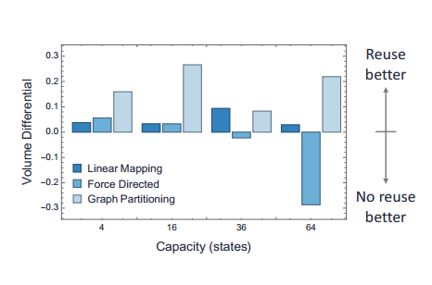
Results: Two-Level
Qubit Reuse:
y-axis of plot is (NR-R)/NR
NR is the quantum volume when qubits are not reused
R is quantum volume when qubits are reused

Slide 34
Results: Two-Level
Allowing qubit reuse reduces the quantum volume for Linear Mapping Baseline and Graph Partitioned circuits

Slide 35
Results: Two-Level
Not allowing qubit reuse reduces the quantum volume of larger circuits optimized by force directed annealing
This may be due to the fact that the area introduced by the extra qubits widens the search space for the annealing algorithm to optimize for latency

Slide 36
Results: Two-Level
- Hierarchical Stitching out- performs the other methods as it is the only method that explicitly addresses the latency introduced by permutations
- For circuit with capacity of 100,
the quantum volume of the hierarchical stitching circuit is reduced by 5.64x from that of the baseline linear mapping circuit

Slide 37
Conclusion
This paper contributes the following:
- Showed strong correlation between quantum circuit latency and number of edge crossings in a program interaction graph representation of the circuit
- Developed a circuit optimization procedure based these correlations
- Demonstrated this procedure can result in up to a 5.64x reduction in quantum volume of some circuits compared to the best optimizations of those circuits to date

Slide 38
Future Work
- Analyze higher level magic state factories
- Study optimization of circuits with expanded area. Force directed procedure works well with larger areas so expanding the area of the circuit to reduce the execution latency

