Slide 1
Principal Concepts behind IBM Q
D. Stancil, Quantum Computing CSC591/ECE592, 14 Oct. 2019
A. Blais, et al, “Cavity quantum electrodynamics for superconducting electrical circuits: An architecture for quantum computation,” Phys. Rev. A, Vol. 9, 062320 (2004)
J. Koch, et al, “Charge-insensitive qubit design derived from the Cooper Pair Box,” Phys. Rev. A Vol. 76, 042319 (2007).
J. Clarke & F. Wilhelm, “Superconducting quantum bits,” Nature, Vol. 453, 19 June 2008, p. 1031.
J.M. Chow, “Quantum Information Processing with Superconducting Qubits,” Ph.D. Dissertation, Yale Univ., 2010.
C.T. Rigetti, “Quantum Gates for Superconducting Qubits,” Ph.D. Dissertation, Yale Univ., 2009.
C. Rigetti and M. Devoret, “Fully microwave-tunable universal gates in superconducting qubits with linear couplings and fixed transition frequencies,” Phys. Rev. B vol. 81, 134507 (2010)
T. Van Duzer and C.W. Turner, “Principles of Superconductive Devices and Circuits,” Elsevier, 1981.
A. Kandala, A. Mezzacapo, K. Temme, M. Takita, M. Brink, J.M. Chow and J.M. Gambetta, “Hardware-efficient variational quantum eigensolver for small molecules and quantum magnets,” Nature, Vol. 549, p. 242 (2017).
D. C. McKay, C. J. Wood, S. Sheldon, J.M. Chow, and J. Gambetta, “Efficient Z gates for quantum computing,” Phys. Rev. A vol. 96, p. 022330 (2017).

Slide 2
Outline
Requirements for a Quantum Computer
Quantum Mechanics of Two State Systems
Rotations
Creating Gates with Rabi Oscillations
Superconducting Qubits
  How to make qubits with circuits
  Superconductivity
  Josephson junction and nonlinear LC circuits
  SQUID: Tunable nonlinear inductance
  Transmon
Entangled transmons and controlled gates
IBM example chip layout

Slide 3
(Subset of) Requirements for Quantum Computer (Paraphrase of DiVencenzo)
Physical system with two uniquely addressable states
A universal set of quantum gates
  Ability to implement arbitrary rotations on the Bloch sphere
  Ability to entangle two qubits
Ability to measure the state of a cubit

Slide 4
Two State Systems in Quantum Mechanics

Slide 5
Schrodinger Equation
H is an expression for the total energy of the system (kinetic + potential) and is called the Hamiltonian
For two orthogonal states:
What if we introduce a perturbation that weakly couples states 0 & 1?

Slide 6
Schrodinger Equation for 2x2 coupled system
This can be written

Slide 7
Prototypical 2-state system: Spin in a Magnetic Field
S
+
B

Slide 8
Time Evolution of a Spin in a Magnetic Field
General solution:
Express coefficients in terms of a “mixing angle”:
Expectation of x spin component:

Slide 9
Larmor Precession
A general superposition state precesses at the frequency of the energy difference between the two states
Measured spin must be described by normal rotation matrices, so it follows that the rotation operators on the state vector must be somewhat different

Slide 10
Rotations

Slide 11
Unitaries representing rotations
Within an arbitrary phase

Slide 12
Arbitrary point on Bloch Sphere
Two rotations can take you from the ground state to any point on the Bloch sphere

Slide 13
Most General 2x2 Unitary
In mechanics, 3 angles are needed to orient an object arbitrarily (e.g., roll, pitch, yaw)
Euler Angles Rotations: 12 different ways of defining the rotations and their order
ZYZ convention of particular interest since we will see that Z rotations can be performed with essentially no error

Slide 14
Representations of most general 2x2 unitary
Or since an overall phase is not observable
Qiskit also defines

Slide 15
Common gates realized with u3

Slide 16
Creating Gates with Rabi Oscillations

Slide 17
Creating Rotations: Rabi Oscillations
Suppose a time-varying field is applied along the x direction
The Hamiltonian becomes
Move to a frame rotating at
Note that rotating a state vector by φ is equivalent to rotating the coordinates by -φ, so the state vector in the rotation frame is

Slide 18
Hamiltonian in the Rotating Frame

Slide 19
Rotating Wave Approximation
Putting the pieces together:
Neglect the frequency components near twice ω₀ since they will tend to average out: Rotating Wave Approximation
Δ = ω_{d} - ω₀

Slide 20
Time Evolution of State Vector in Rotating Frame
If the drive frequency matches the qubit frequency, Δ = 0.

Slide 21

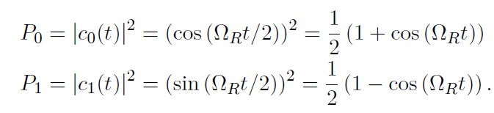
Example: Rotation About x Axis
Note that the rate of rotation can be controlled by varying either the amplitude or the phase of the microwave drive signal

Slide 22
Realizing Gates using Rabi Oscillations
Recall that when driven at resonance
“π-pulse”: inverts the state
“π/2-pulse”: creates equal superposition of states
Key point: you can flip a state or create a superposition state by controlling the pulse length and/or amplitude & controlling the phase of the excitation
X gate: pi-pulse with
Y gate: pi-pulse with
Z gate: Rotations around the z axis can be accomplished simply by resetting the phase reference of the RF drive! Result: zero time and zero error (“Virtual Z Gate, VZ”)
This is a key point for an important error mitigation technique: Richardson extrapolation
z
y
x

Slide 23
Superconducting Qubits

Slide 24
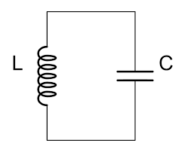
Qubit possibility: LC Resonant Circuits?
In classical, linear circuit theory, the natural solution for the current is
The current can have any amplitude, independent of the frequency
Energy is stored alternately in the electric field of the capacitor and the magnetic field of the inductor, and can have any value
In reality, the stored energy is quantized
Could we use two of these states for a qubit, say n=0 and n=1?

Slide 25
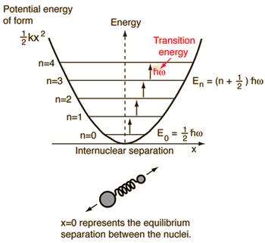
Nonlinear Resonant Circuits
Problem: energy difference between 0,1 is the same as energy difference between all other states n,n+1
  No way to address specific states
Solution: if either L or C were nonlinear (i.e., their values depended on the magnitude of the current or voltage), then the energy levels would no longer be equally spaced!
  If the energy difference between n=0 and n=1 is different from the energy difference from all other states, we can selectively address this particular transition by tuning the frequency of the applied excitation
Graphic: http://hyperphysics.phy-astr.gsu.edu/hbase/quantum/hosc.html
Graphic: Clarke & Wilhelm

Slide 26
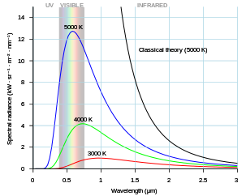
RF Frequency
The fact that we are talking about circuits suggests we are talking about RF rather than optical frequencies!
Problem: any physical mass at finite temperature will emit electromagnetic radiation that depends on its temperature (Black body radiation)
  We want the energy difference between qubit states to be large compared to thermal radiation
  Highest frequency for widespread, economical instrumentation ~ 6 GHz (owing, e.g., to WIFI, etc.)
  From kT=hf, the temperature corresponding to 6 GHz is 0.29K
  Operating temperature must be much less than 0.3K!
Solution: IBM Q systems operate at a temperature of about 15 mK using dilution refrigeration
Graphic: Wikipedia

Slide 27
Superconductivity
At such low temperatures, metals such as Al and Nb become superconductors
  At low temperatures, an attractive force between electrons appears
  When this force gets sufficiently strong compared to thermal vibrations, electrons bind together into “Cooper pairs” with spin 1 and charge 2q
  Cooper pairs form a macroscopic quantum state enabling charge to move without scattering or loss, resulting in superconductivity
Makes it possible to realize extremely low-loss RF transmission lines
Makes it possible to realize a nonlinear inductor using a Josephson junction

Slide 28
A note to Physicists: Cooper Pairs and Superconductivity
Spin ½ particles are “Fermions”
  Fermions obey the Pauli exclusion principle: no two can be in the same state
  Electrons are Fermions
Spin 1 particles are “Bosons”
  Bosons do not obey the Pauli exclusion principle: you can have as many in a state as you want
  Photons are Bosons
In a superconductor, an effective attractive interaction between electrons causes them to be loosely bound together and act like a single spin 1 particle: “Cooper Pair”
Since Cooper pairs are spin 1, they act like Bosons, and you can have multiple Cooper pairs in the same state
All of the Cooper pairs in a macroscopic sample can be in the same coherent state

Slide 29
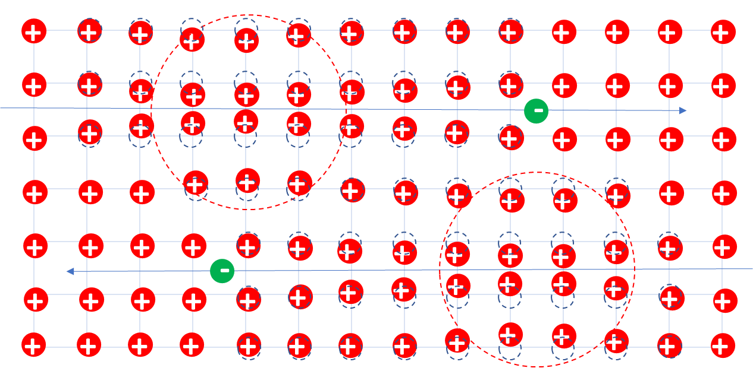
Cooper Pairs are the result of the Electron-Phonon interaction in the theory of Bardeen, Cooper, and Schreifer (BCS Theory)
Electrons normally repel one another, but are attracted to ions in the crystal lattice
If the ions are pulled slightly toward an electron, from a distance it can appear as though there is a net positive charge, attracting another electron

Slide 30
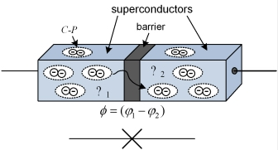
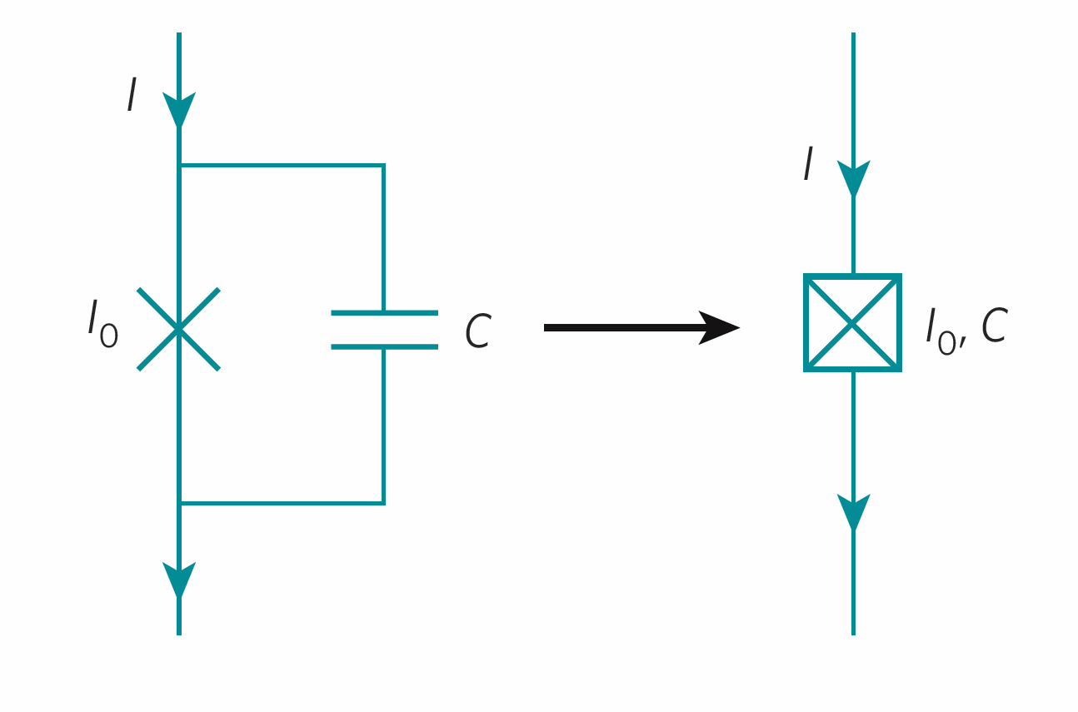
Josephson tunnel junction
Circuit Symbols
Graphic: Clarke & Wilhelm
Two superconductors separated by a thin insulating layer
Wave functions for superconducting Cooper pairs decay exponentially in the insulating layer
If the layer is thin enough to allow appreciable tunneling, then phases are no longer independent but are related to each other through the size of the tunneling current
Graphic: Ph.D. thesis: Vratislav Michal

Slide 31
Josephson Junction as nonlinear inductor
Effective inductance depends on the current
Looks like a non-linear inductor: origin of anharmonicity: spacing between energy levels is not the same
  Enables the individual addressing of a single pair of states
  In contrast, in a linear circuit, all states are equally spaced
Image credit: Doug McClure, IBM

Slide 32
Superconducting Quantum Interference Device (SQUID)
Parallel Josephson Junctions
Magnetic field induces circulating current
Simple analysis: neglect inductance of loop, assume both JJs are identical
The second equation comes from integrating the canonical momentum around the loop (See e.g., Van Duzer & Turner)
If the total current is zero:
Thus applying a magnetic field will induce a current, and consequently tune the inductance

Slide 33
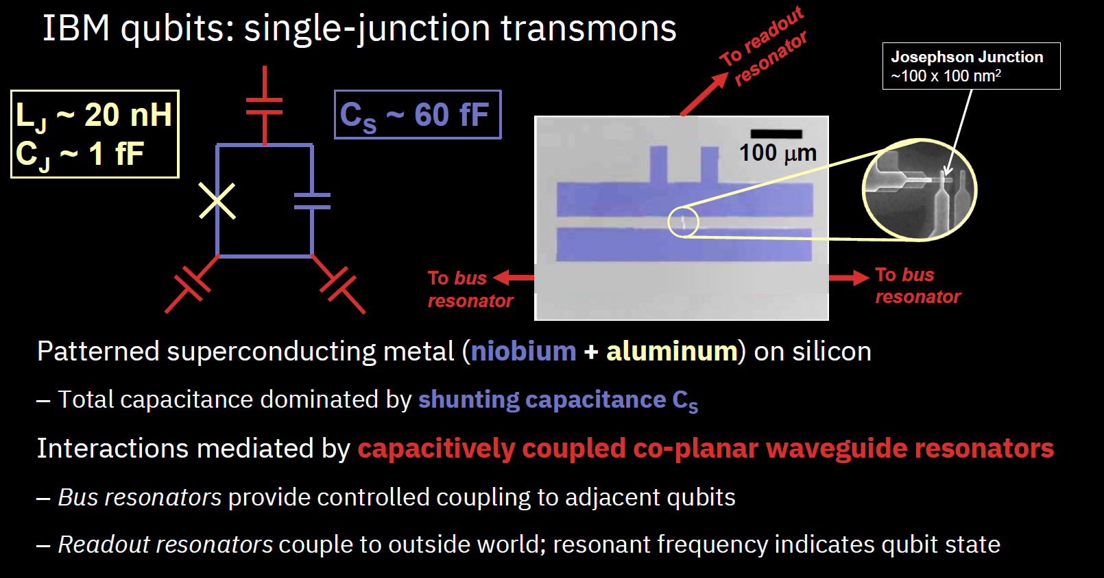
Slide credit: Doug McClure, IBM

Slide 34
Coupling to a Transmon
Co-planar microstrip resonator formed by gaps in center conductor
Important to properly choose resonator frequency with respect to transmon frequency (more to come)
Control is achieved by injecting an RF signal from one end
Readout is achieved by looking at either the transmitted or reflected signal
Blais, et al

Slide 35
Other Transmon Designs
Flux Tunable Qubits
Fixed FrequencyQubits
Coplanar microwave resonator
Current control line
Chow, PhD Thesis

Slide 36
Slide credit: Doug McClure, IBM

Slide 37
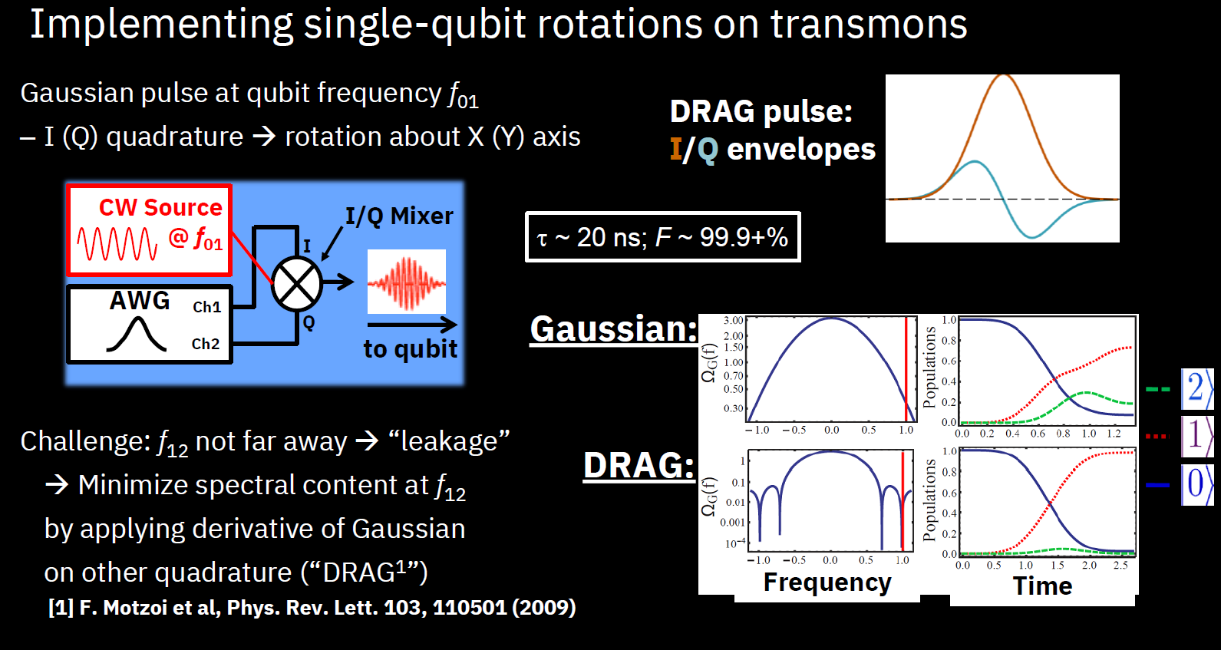
Slide credit: Doug McClure, IBM

Slide 38
Derivative Removal by Adiabatic Gate (DRAG) Examples

Slide 39
Control and Read-out
When the microstrip resonator is detuned from the transmon frequency, interaction with the transmon splits the resonator response into two modes, depending on the transmon state
Sending in a pulse near ω_{r} enables you to read-out the state either from the phase, or the amplitude
Sending in a pulse detuned from the microstrip resonator but tuned to the qubit frequency rotates the state, but does not make a measurement (there is no information about the state in the reflected signal, the resonator is so far off resonance)
Blais, et al

Slide 40
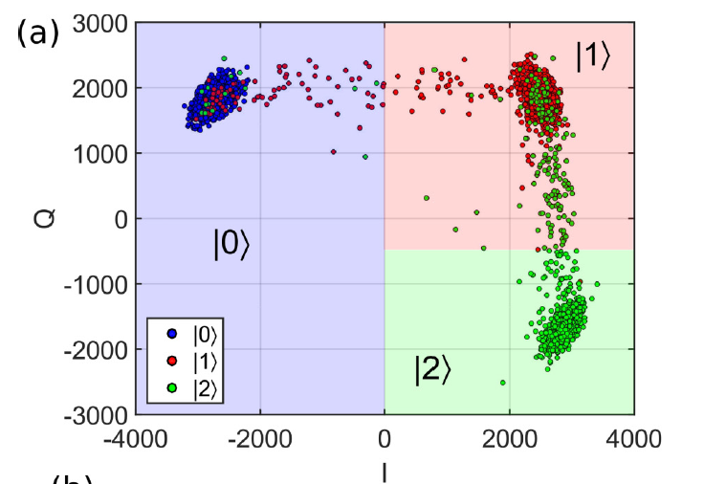
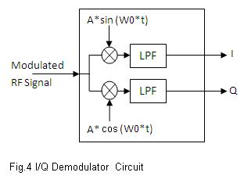
I Q Constellation of Measured Signal
https://www.rfwireless-world.com/Terminology/heterodyne-receiver-versus-homodyne-receiver.html
McKay, et al Phys Rev A 96, 022330 (2017)

Slide 41
Entangling Two Qubits

Slide 42
Slide credit: Doug McClure, IBM

Slide 43
Cross-resonant coupling
Frequency switches on coupling
Amplitude controls the gate speed
Phase determines the two-qubit gate
Rigetti and Devoret

Slide 44
Example IBM Chip Layout
Kandala et al.

