Slide 1
Qiskit Programming Exercise: Teleportation
G. Byrd - HPCA Tutorial - Feb 22, 2020

Slide 2
Quantum Teleportation?
Can transmit and reconstruct the state of a qubit, using two classical bits and a pair of entangled qubits. State of the original qubit is destroyed.
This is known as "teleportation."

Slide 3
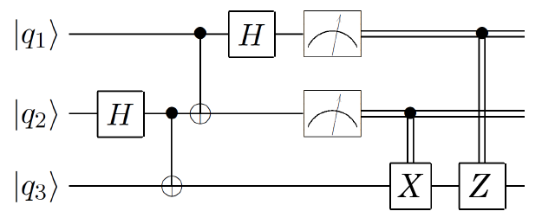
Teleportation (1)
$$a|0〉+b|1〉$$
Alice
BOB
Alice wants to send q1 to Bob. Alice does not know the state of q1.

Slide 4
Teleportation (2)
$$a|0〉+b|1〉$$
Alice
$$|0〉$$
BOB
$$|0〉$$
First, an EPR pair is created -- an entangled pair of qubits in state $|00〉+|11〉$. (Leaving off normalizing coefficients for simplicity.)
Full state of 3-qubit system is
$$a|000〉+a|011〉+b|100〉+b|111〉$$

Slide 5
Teleportation (3)
$$a|0〉+b|1〉$$
Alice
BOB
Next, Alice performs operations on her two qubits, and state becomes:
$$\left.a(|000〉+|011〉+|100〉+|111〉)+b(|010〉+|001〉−|110〉−|101〉\right)$$
$$\left.|00〉(a|0〉+b|1〉)+|01〉(a|1〉+b|0〉)+|10〉(a|0〉−b|1〉)+|11〉(a|1〉−b|0〉\right)$$

Slide 6
Teleportation (4)
$$a|0〉+b|1〉$$
Alice
BOB
Alice measures her two bits, which forces Bob's bit into one of the four states.
$$\left.|00〉(a|0〉+b|1〉)+|01〉(a|1〉+b|0〉)+|10〉(a|0〉−b|1〉)+|11〉(a|1〉−b|0〉\right)$$

Slide 7
Teleportation (5)
$$a|0〉+b|1〉$$
Alice
BOB
$$a|0〉+b|1〉$$
The two measured bits (classical) are sent to Bob. At that point, he knows the state of his qubit, and he "corrects" it using X, Z, or both (Y), to recover the original state.
$$\left.|00〉(a|0〉+b|1〉)+|01〉(a|1〉+b|0〉)+|10〉(a|0〉−b|1〉)+|11〉(a|1〉−b|0〉\right)$$

Slide 8
Assignment
$$a|0〉+b|1〉$$
Alice
BOB
Use qiskit to implement the circuit and demonstrate that it works.
(Only works with simulator)
Q: How do you know if Bob's qubit matches the original? There's no direct way to observe the actual state $a|0〉+b|1〉$, even in the simulator.

