Slide 1
Object Transportation System Using LEGO Mindstorms RCX Term project for CSC714
David Boyuka
Vishnu Dasa Harish Babu

Slide 2
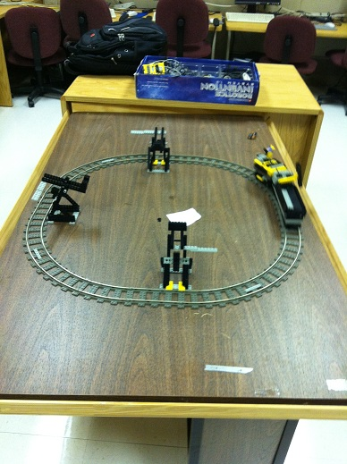
Problem Statement
Objective: transport objects from “input bins” to the “output bin”, under various real-time constraints
Single delivery vehicle, circular track, unlimited object capacity
Real-time constraints:
Periodic tasks for input bin checking
(deadline = period)
Sporadic task released when
object(s) are picked up, with
deadline specific to each bin

Slide 3
Real-Time Challenges
“Typical” approach to scheduling is naïve
WCET can be bounded more tightly by incorporating current location and distance to bins
Sporadic tasks for object delivery aren’t “typical”
All objects are delivered at once, no separate WCETs

Slide 4
Our Algorithm Idea
Incorporate “lookahead” by calculating slack remaining after a move
Slack = deadline – (WCET given
current location)
Example:
Bin check time = 1sec
If check C then B, B’s deadline is missed
But, if check B then C, success
Slack check algorithm finds negative
slack for B if we check C then B, so it
decides on the correct strategy (B first)
Deadline = 9
B
3 sec
3 sec
Deadline = 8
A
C
Train here
at t = 0

Slide 5
Progress and Todo List
Done:
Physical construction is complete
Vehicle movement, “bin checker” arm, object dumper, location sensor, object pickup sensor
Low-level code and scheduler interface complete
Some prototype scheduling algorithms coded
Todo:
Finalize scheduling algorithms we want to compare
Use various test scenarios to evaluate/showcase algorithms

Slide 6
Problems Faced
Light sensor was not sensitive enough for an object pickup detector. We switched to using a rotation-sensor-based mechanism.
Much difficulty calibrating touch sensor to read station markers on track. Also, our first touch sensor turned out to be broken…
Train derailed itself until we found the correct speed
Algorithm design tricky because some assumptions are different than in the RT systems we have studied

Slide 7
Demo

Slide 8
Thank you

